Slide 1
GSAA-HBS Virtual Crosscover Playbook
April 2021
Viet Tran
Sean Shargh

Slide 2
Background
During recent COVID surges, ‘Virtual Cross-cover’ was emergently implemented in facilities that were overwhelmed and understaffed.
HBS from other facilities were able to remotely cover pages, inbaskets, and staff messages.
Overall excellent feedback given the desperate situation.
This has sparked the evolution of cross-cover where applicable, locally.
Groundwork already established in other areas: Telemetry, Tele-ICU

Slide 3
Goal/Benefit
Offload burden of nonurgent, tedious cross-cover issues from ‘In-House HBS’ to allow them to focus on Consults and Overhead Calls
Provide extra layer of support for FRE evening providers
Smooth transitions during hand-off times (~8pm)
Allow for operational flexibility during high census times

Slide 4
Go-Live for GSAA
Go-Live: April 12
Coverage: Single HBS provider to cover both SLN & FRE between 6pm to 12am daily
Built into schedule: 1.5 units of ‘HBA’ activity

Slide 5
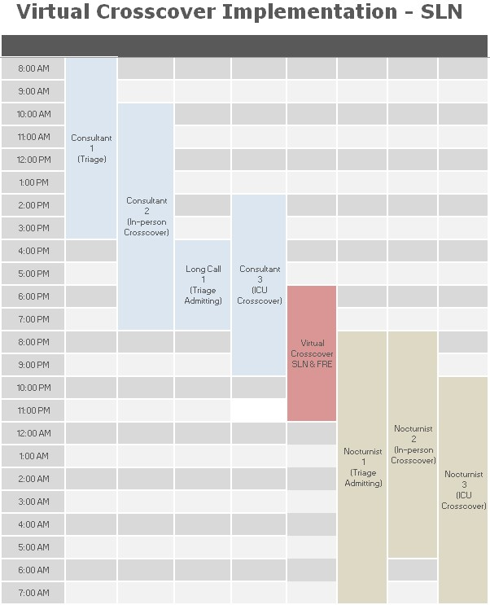
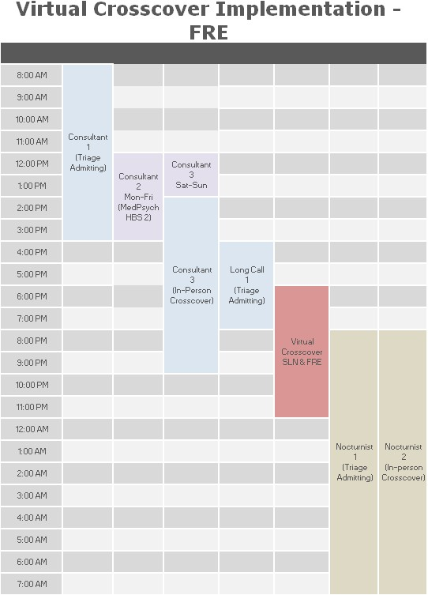

Slide 6
Expectations
Maintain same quality of cross-coverage
Ensure home workspace and equipment (laptop, KP iPhone) are operational
Clear out system Sign-Out lists for both facilities.
*For those adding to lists, please be clear on requested course of action.*
If ‘Virtual HBS’ determines cross-cover issue requires in-person evaluation, ‘Virtual HBS’ will directly reach out to designated ‘In-House HBS’.
*Do NOT use RN as a middle-person*
Minimize use of verbal orders. Computer ideally accessible at all times.

Slide 7
Expectations
End-of-Shift Handoff
Text or verbal sign-out to corresponding ‘In-House’ CrossCover HBS provider
Acknowledgement required
Pending labs or imaging
Prior sign-out from primary team or specialist regarding patient care

Slide 8
Exclusions
Responsibilities to remain with In-House HBS:
ICU cross-cover
Overhead Codes
AAM alerts

Slide 9
Backup Scenarios
Technical failure
If unable to resolve issue in timely manner, and no alternative method (KP iPhone), then will need to come to closest facility to perform duties.
Sick-call
If known in advance, query will go out to group for volunteers.
If last minute, cross-coverage will revert to traditional ‘In-House HBS’ coverage (HBA 2 in SLN, HBA 3 in FRE). This will require communicating to operators and updating WebServices.

Slide 10
Approximation
FRE Overnight Floor Crosscover
SLN Overnight Floor Crosscover
Number Of Nights Recorded | 22
Total Calls | 409
Highest Nightly Calls | 46
Lowest Nightly Calls | 5
Average Number Of Calls | 19
Number Of Nights Recorded | 25
Total Calls | 704
Highest Nightly Calls | 69
Lowest Nightly Calls | 9
Average Number Of Calls | 29
Notes:
Thanks to prior work by Joe and Nelson to identify common themes in crosscover calls OVERNIGHT.

Slide 11
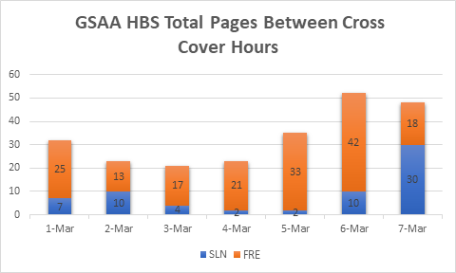
Anticipated Volume
Graph shows paging volume between 6pm to 12am for one week
Increasing sample size to 1 month for better representation
Note: Disparity between SLN & FRE is revealing a great opportunity to evaluate the RN culture and practices. More work to come in RN-HBS agreement.

Slide 12
Roll-Out Plan
Slide deck and handout/flyers sent to nursing leads
Attend RN huddles to socialize workflow changes; Q&A
Ongoing communication with RN educators for feedback

Slide 13
Data Collection and Review
Viet/Sean to follow up with provider in AM:
Review text chain for approx number of pages
Approximate number of In-House deferrals
Comments/Suggestions
Shift is subject to change based on learnings

Slide 14
Future Enhancements
Evaluate patients via video/iPad with RN assistance
Ongoing nursing education/reinforcement on nonurgent vs urgent issues
FRE’s (and SLN’s) RN paging culture drilldown

Slide 15
Important
Please remember to remain professional and collegial when interacting with support staff (RN, RT, etc) and colleagues. As with any new workflow, there will be an adjustment period so anticipate the need to periodically (and politely) educate staff on appropriate use.

Slide 16
APPENDIX
RN Guidelines & Flyer

Slide 17
Attention all RNs:
HBS is implementing new CrossCover protocols for the entire GSAA (San Leandro & Fremont).
Please see below for details.
Go-live: April 12, 2021
New Protocol:
A single HBS provider will ‘Virtually’ cover NONURGENT CrossCover issues for both facilities between the hours of 6pm to 12am.
‘In-House’ HBS providers will remain available in both facilities for URGENT CrossCover issues (those requiring in-person evaluation).
ICU level Crosscover duties will remain with designated ‘In-House’ HBS provider.
ASK:
Determine the appropriate urgency of CrossCover issues.
Identify the designated HBS based on urgency and need for in-person evaluation.
Refer to WebServices to page/call appropriate HBS provider (‘Virtual’ vs ‘In-House’).
Please review WebServices example labels.
Please review CrossCover guidelines/examples.
For questions, comments, or suggestions, please reach out to Drs Viet Tran and Sean Shargh.

Slide 18
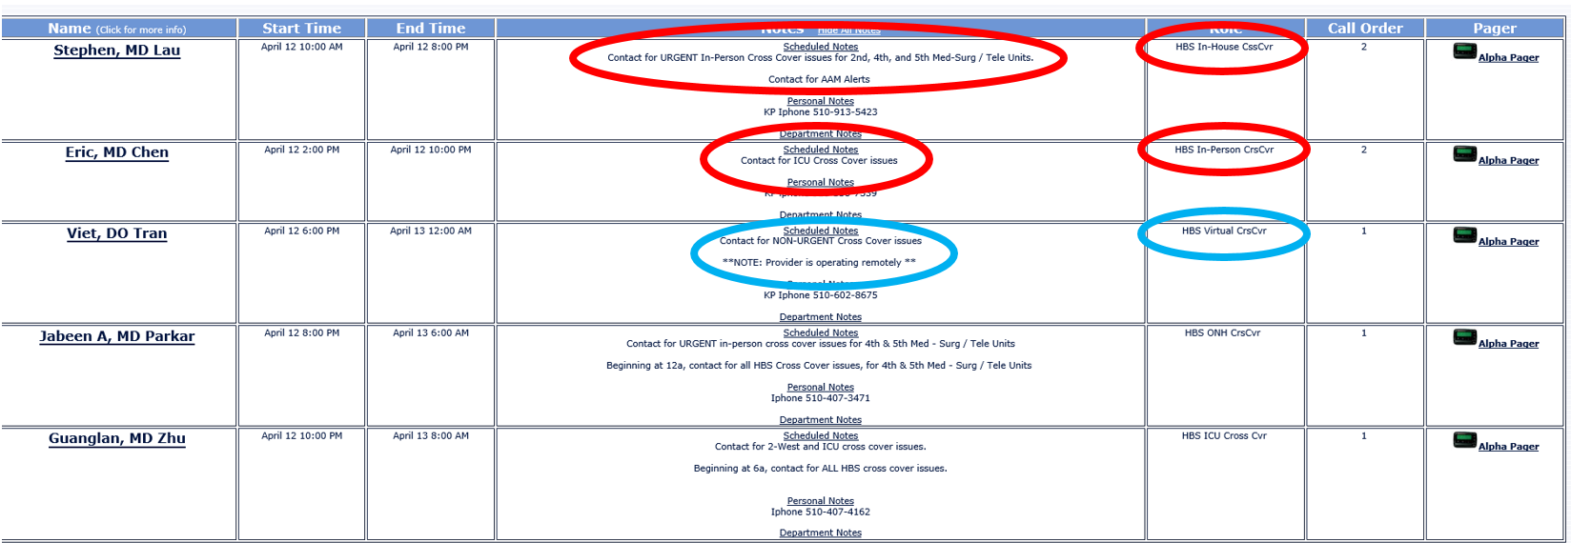
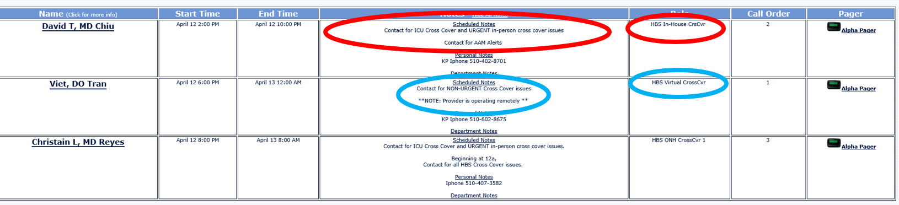
San Leandro Example
Fremont Example

Slide 19
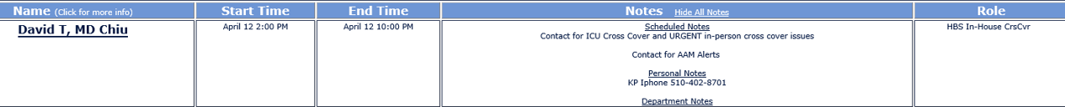
Project analysis slide 4
GSAA HBS Virtual Cross-Cover
RN Communication Process
In-person HBS contacts RN and addresses
RN contact “in-person cross-cover ” HBS on Webservices
Tasks
RN needs to communicate with HBS after hours
Does this require an in-person evaluation?
Yes
No
Webservices Urgent Example:
Schedules
RN contact “virtual cross-cover ”on Webservices
Webservices Non-Urgent Example:
Virtual CrossCover hours:
Resources
6pm to 12am
HBS contacts RN and addresses
For questions, comments or suggestions please reach out to Drs Viet Tran and Sean Shargh
Notes:
Urgent vs Nonurgent guidelines.
What exactly requires in-person evaluation?
Highlight hours of operation
Attend nursing meetings for spreading workflow
Send deck to Damon and Dana for feedback

Slide 20
CrossCover Guidelines/Examples
Urgent: ● Change in vital signs (hypotension, tachycardia, hypoxia, tachypnea) ● Abnormal telemetry finding ● New fever (with no change in other vital signs) ● New change in mental status or neurologic status (such as in stroke or seizure patients) ● Delirium and agitation such as in elderly dementia patients) ● Unexpected falls ● Hypoglycemia / hyperglycemia ● Chest pain ● Facial swelling or signs of airway compromise (change is RR, wheezing, stridor) ● Active bleeding (bright red blood or black stools) ● Patients who wants to leave AMA ● No IV access ● Informing physician about stat lab results and studies (EKGs, CT scans, X-rays) are available for review ● Critical lab values (such as increasing lactate and high troponin) ● Medications ordered incorrectly (such as at the wrong time or for the wrong patient) ● Pain management (not including chest pain) | Non urgent: ● Lactate that has normalized (no more blood draws should be done, unless indicated by the MD) ● Discontinuing droplet and contact precautions when tests are negative ● Request to order AM labs ● Troponin that is decreasing (no more blood draws should be done unless advised by the MD) ● Update family about patient’s medical condition/plan unless there is a new change ● Update family on imaging results unless new critically abnormal result needs immediate action which should be physician’s discretion ● Make the ADT tele and the cardiac monitor order match, unless the patient was just admitted by the physician ● Convert ADT from OBS to inpatient ● Requesting order for already existing Foley catheter ● Low urine output at end of shift (unless there is no urine output or there is concern for obstruction) ● Request for sleeping medication ● Request for bowel regimen ● Request for cough medication ● Order for Wound Care consult (especially in the middle of the night) ● Medications for itching ● Orders for creams and Nystatin powder ● Patient refusing medications, blood draws, or medical care (as long as patient has another site of IV access available) ● Changing routes of medications (such as PO to via NGT) ● My patient has a procedure in the morning. Should they be NPO? (NOTE: RN should keep patient NPO after midnight while waiting for a response) ● My patient just got back from a procedure. Can they have a diet? ● Changing frequency of fingerstick glucose checks when patient is NPO ● Order for CPAP or BiPAP when patient has already been placed on it by RT ● Restraint renewal ● Okay to shower ● My patient’s PICC line is occluded. Can you order Cathflo? ● Confirm nasogastric/orogastric tube and PICC line placements (if no medications/fluids/tube feeding immediately due)

